Slide 1







Middle East’s Most Reliable & Efficient Freight Forwarders & Logistics Operators

Slide 2


Introduction
Founded in 1990
Corporate Office at Jeddah, Saudi Arabia
Leaders in the Logistics Sector
Pioneers in Integrated Logistics & Supply Chain Solutions

Slide 3
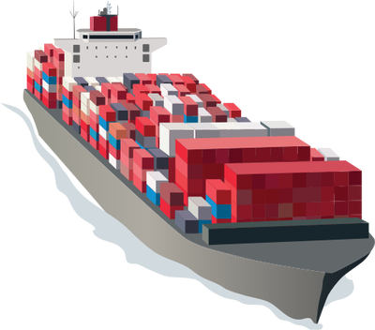
Regional & Global Offices
Branches
Riyadh
Dammam
Jubail
Rabigh
International Offices
UAE
China
India
Terminal Facilities
Jeddah
Dammam
Jubail
Hong Kong
Rabigh

Slide 4

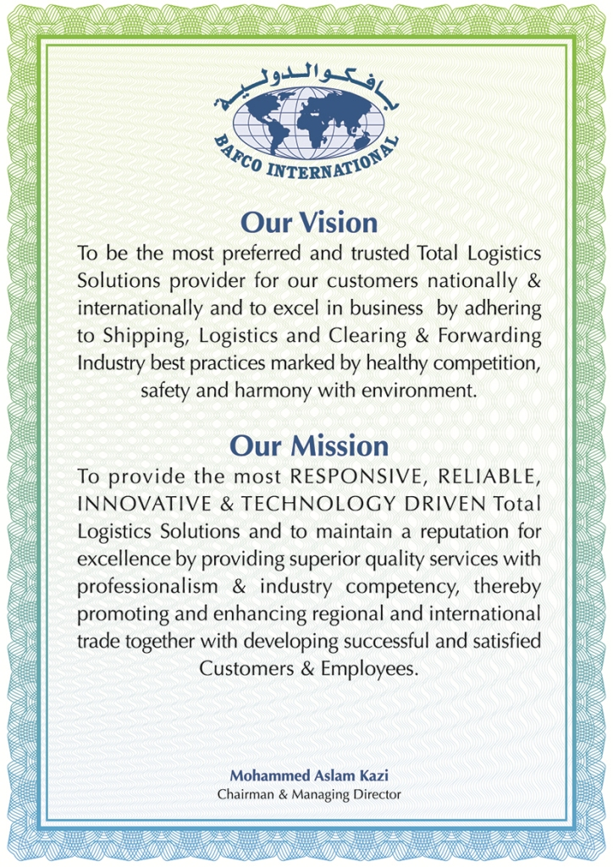
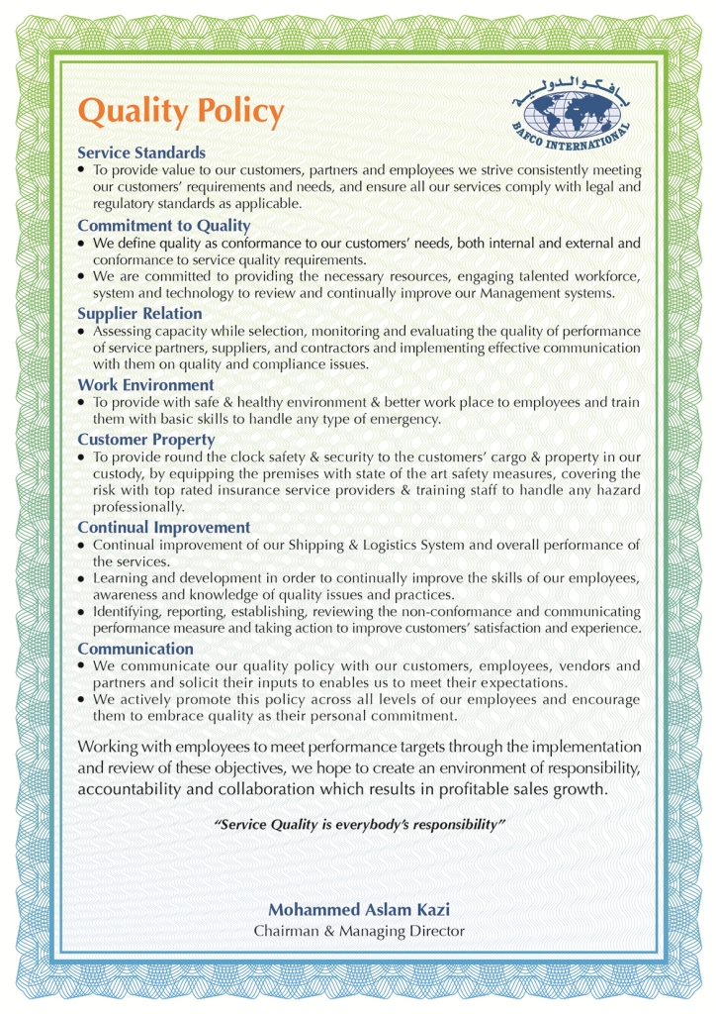

Slide 5
ISO 9001: 2008 Standard Certification

Slide 6
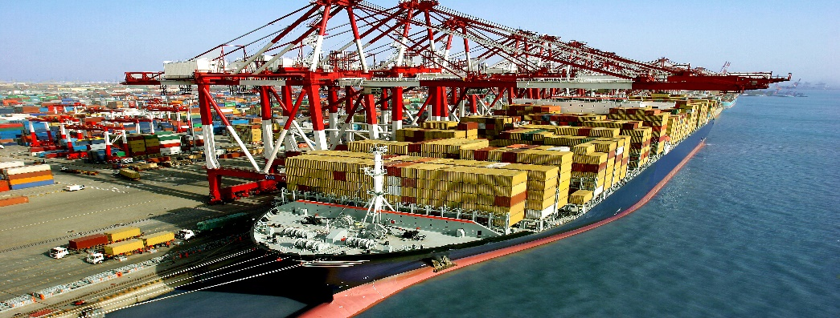
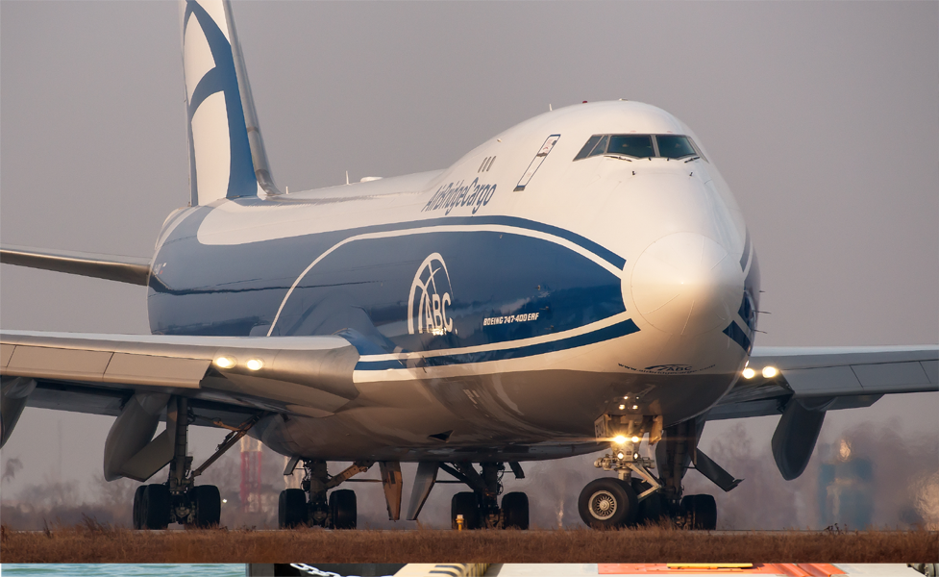
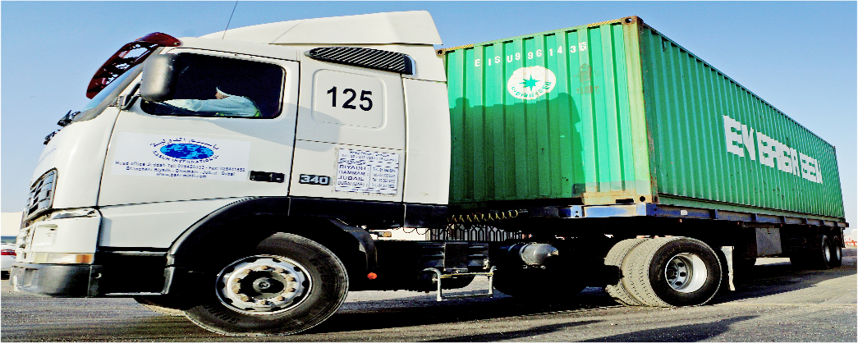
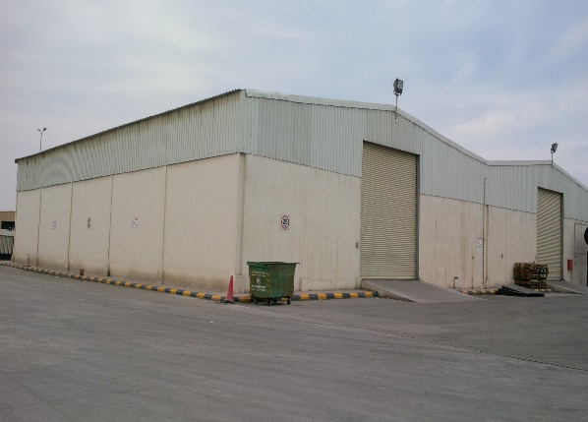
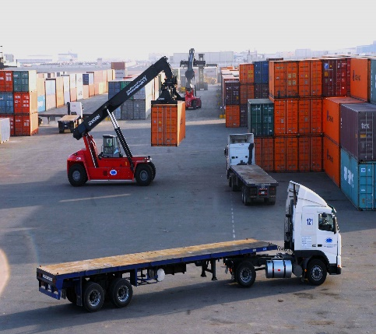
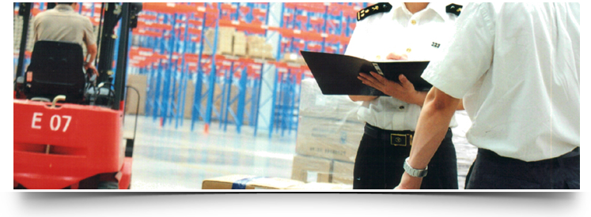
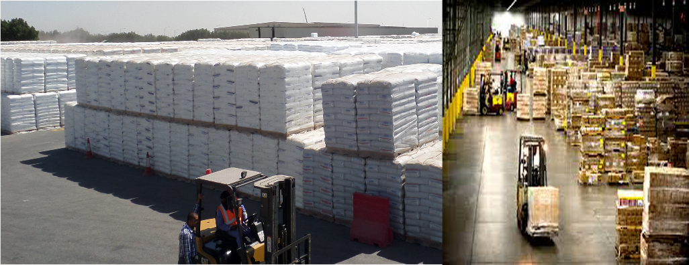
Services
Sea Freight
Air Freight
Transport
Warehousing
Custom Clearance
3 PL

Slide 7
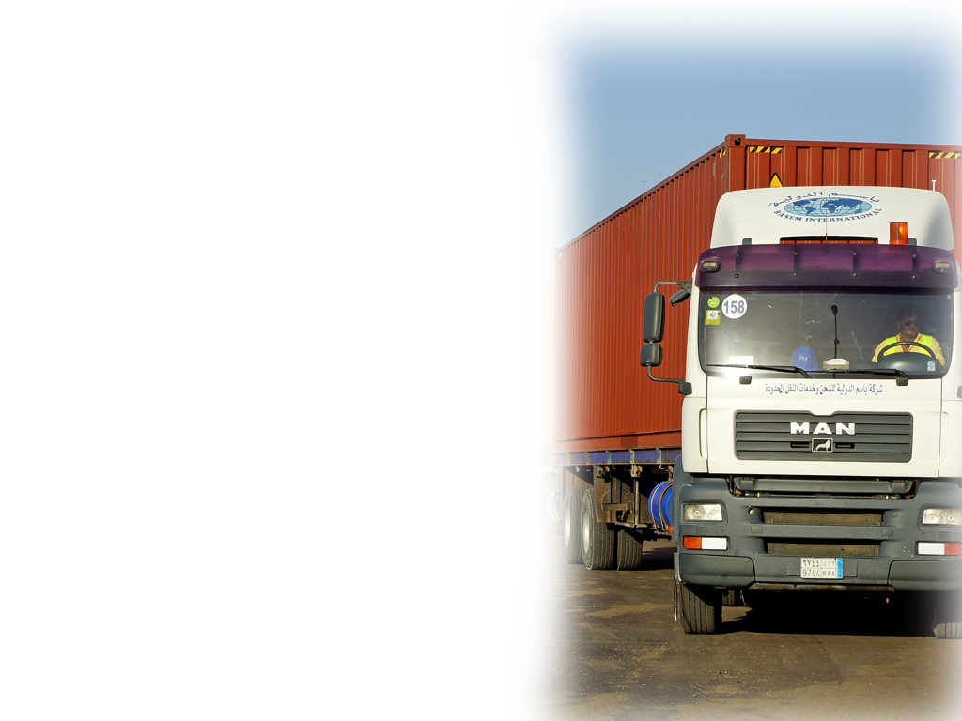
Transportation Highlights
Container transportation services to / from
Jeddah, Yanbu, Rabigh, Madina, Riyadh, Jubail & Dammam .
Modern Fleet of Trucks & Low-bed and Flat-bed Trailers, under the control of its Transport Division.
Each Trailer is insured with haulier’s liability, covering cargo & container
Efficient Fleet Management by professional team.

Slide 8



Infrastructure

Slide 9
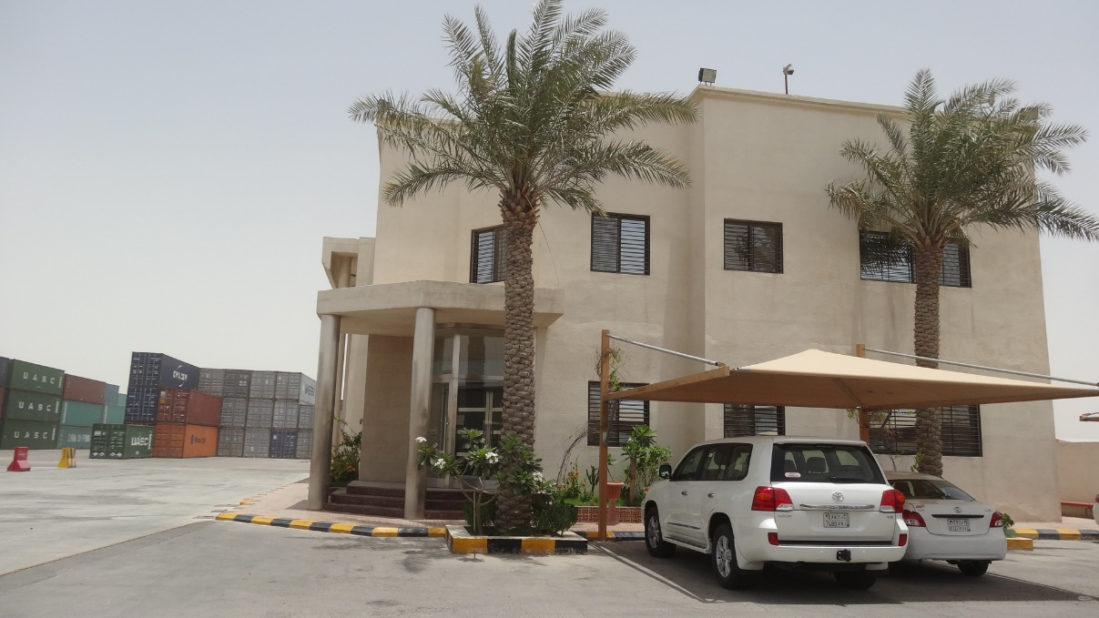
Dammam Office & Terminal

Slide 10

Jeddah Terminal

Slide 11
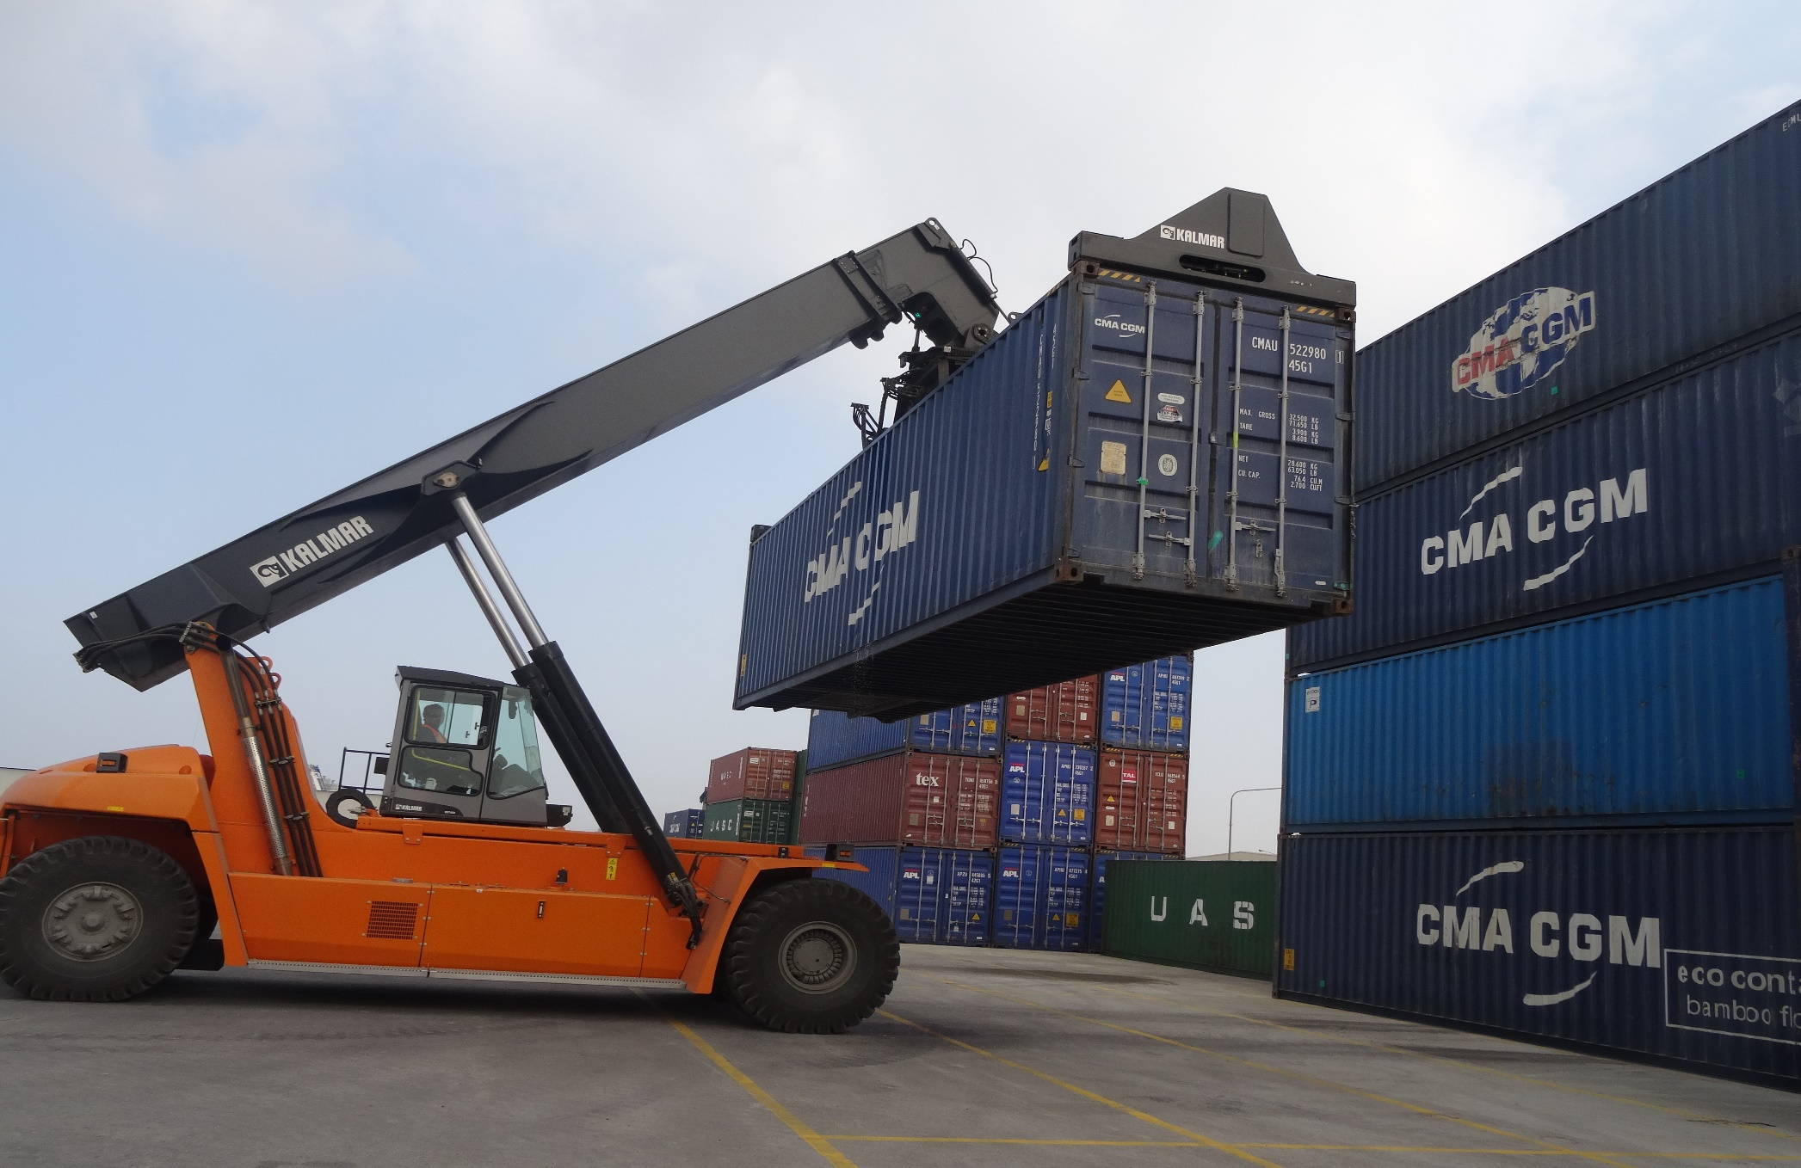
Jubail Terminal

Slide 12
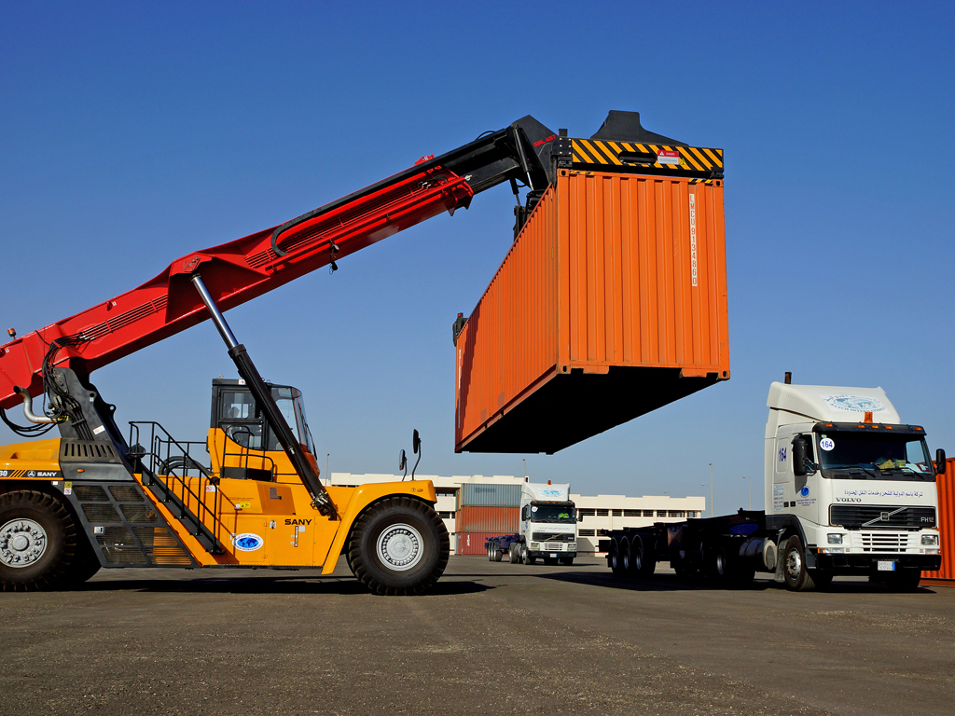
Own Fleet Of Container Handlers
We handle your cargo with sophisticated equipment, with utmost care. With owned container handlers both laden and empty adds advantage

Slide 13
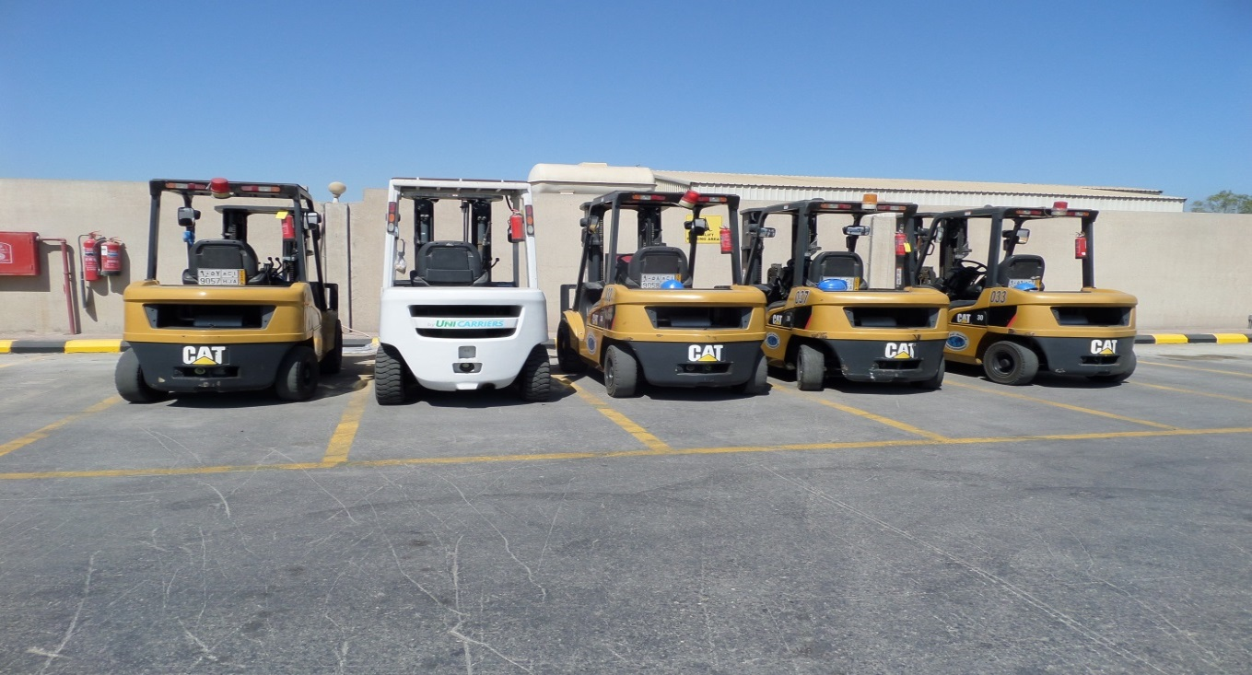
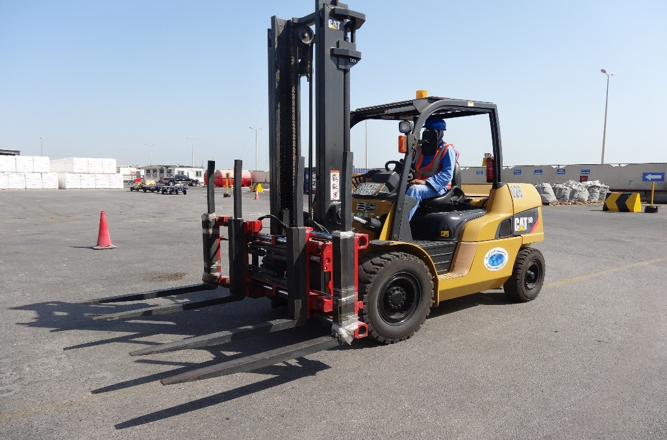
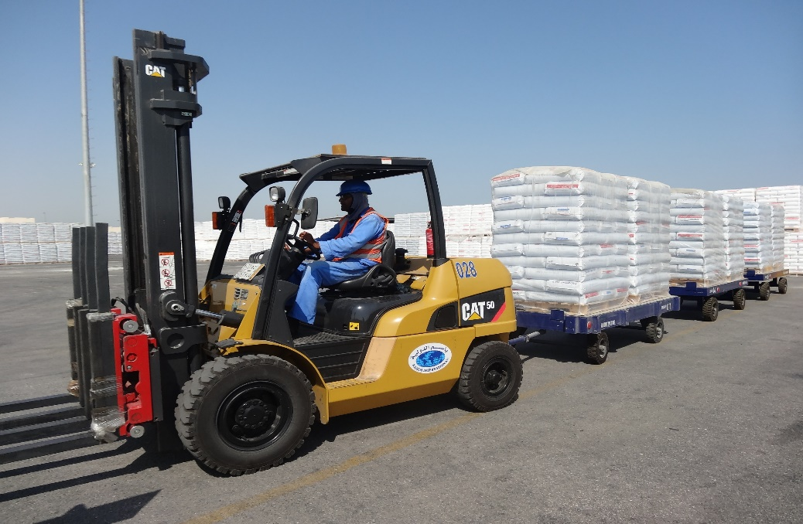
Forklift for Offloading / Loading

Slide 14
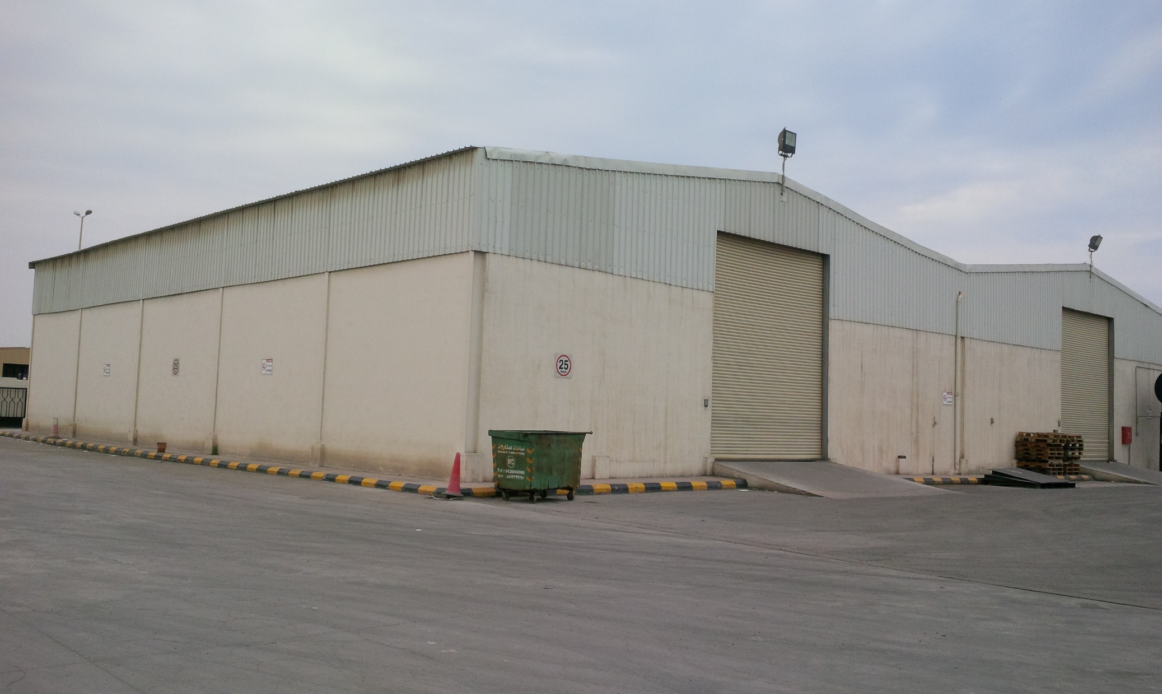
Warehouse facility in Dammam

Slide 15
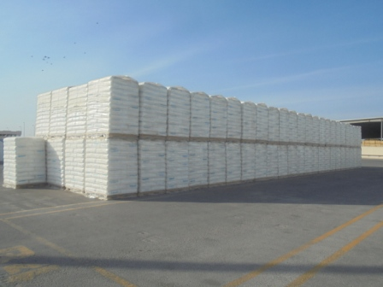
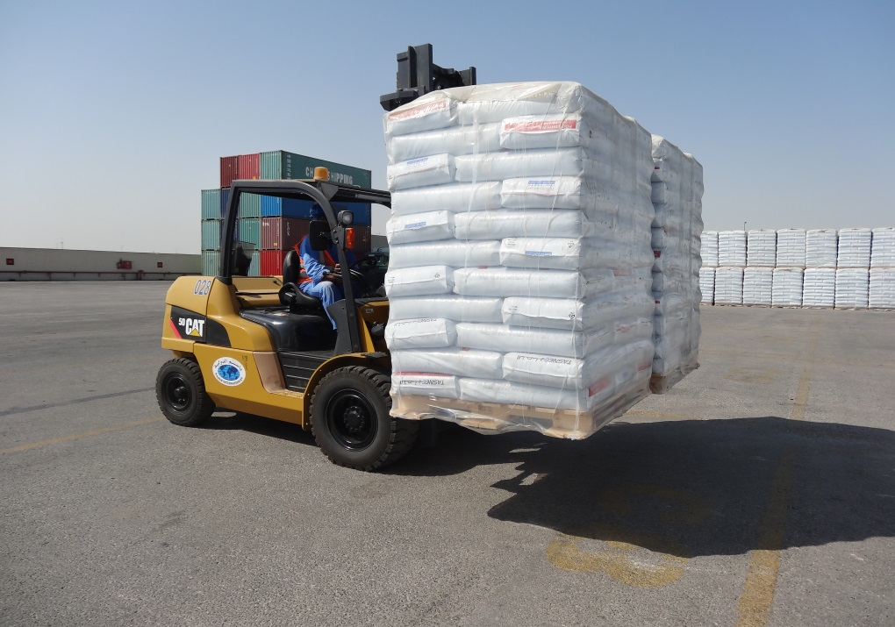
Integrated 3PL Management-Dammam
Dedicated Facility for Polymer Resin Industry.
50,000 sq mt. terminal close to Dammam port.
Material receiving & storage facility.
Wrapping and Reworking facility for damaged pallets
Double pallet handler for faster loading and unloading
Executing loading and dispatch as per planning
Inventory management & Online updating
Shuttling loaded containers to the exit ports.

Slide 16
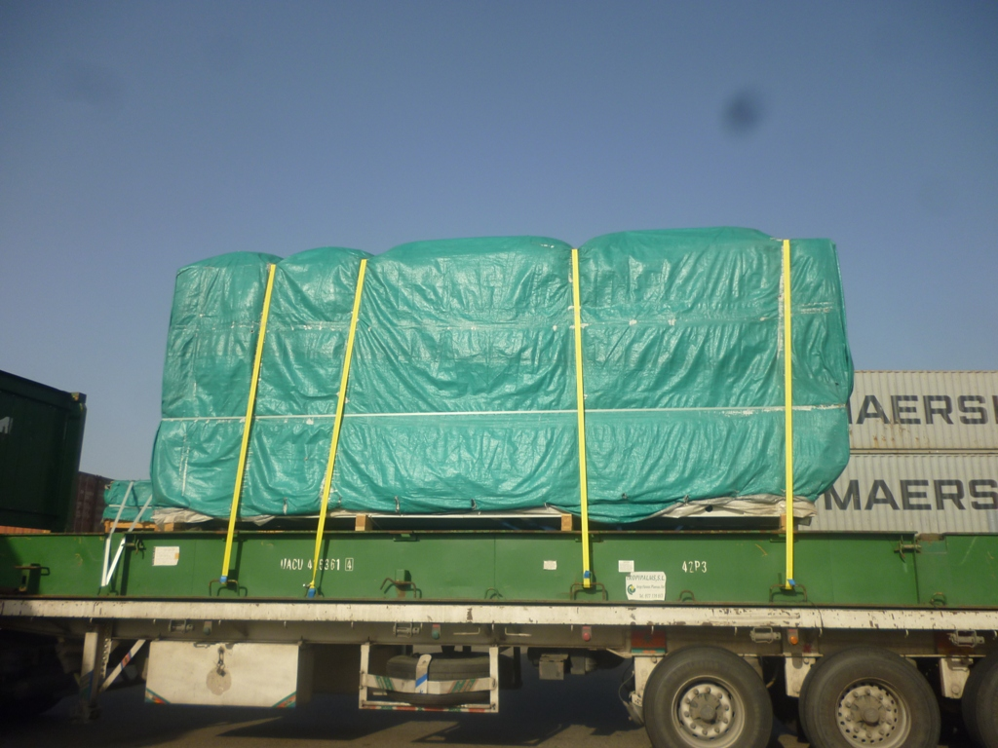
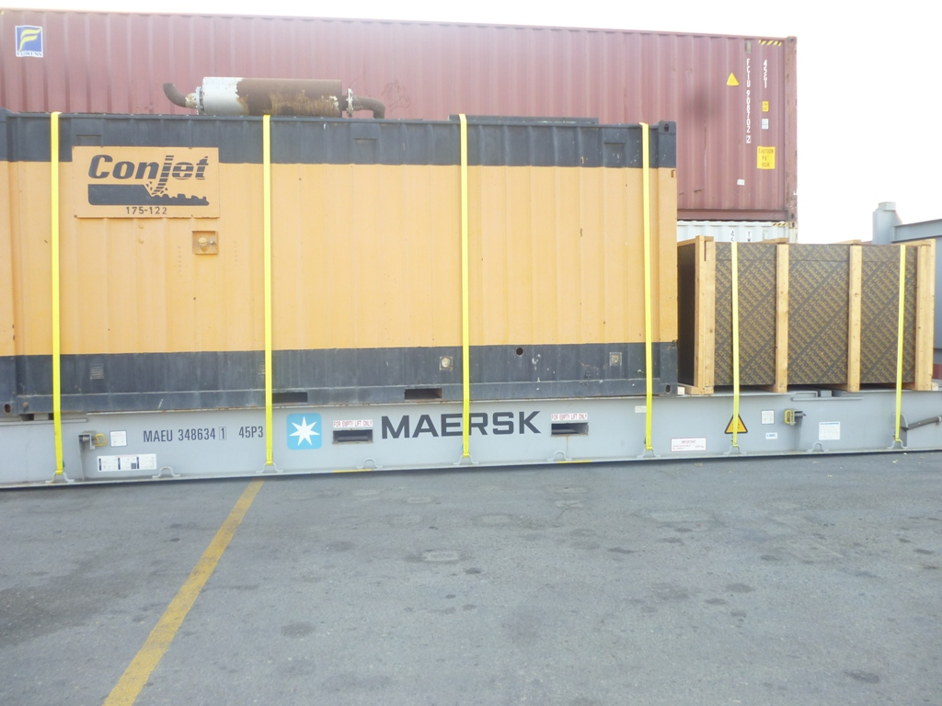
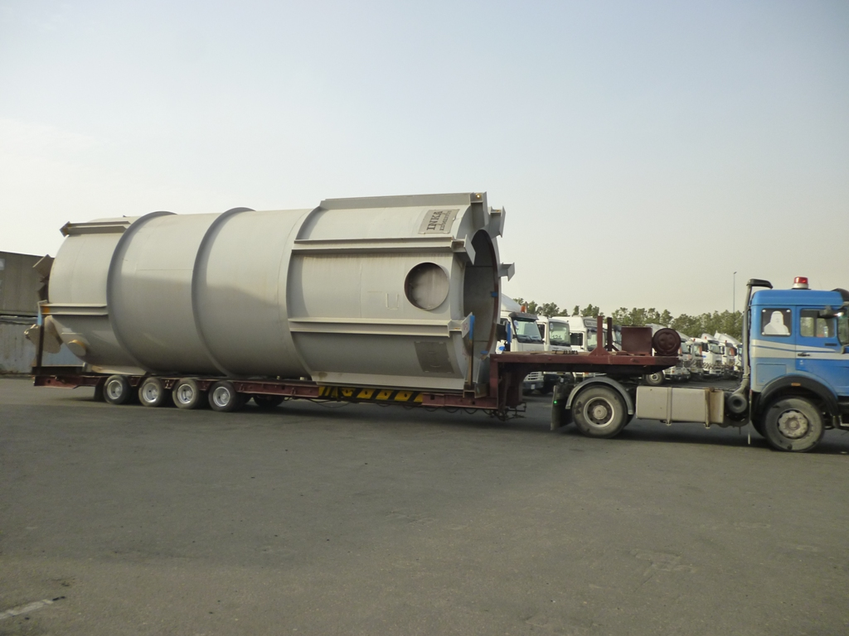
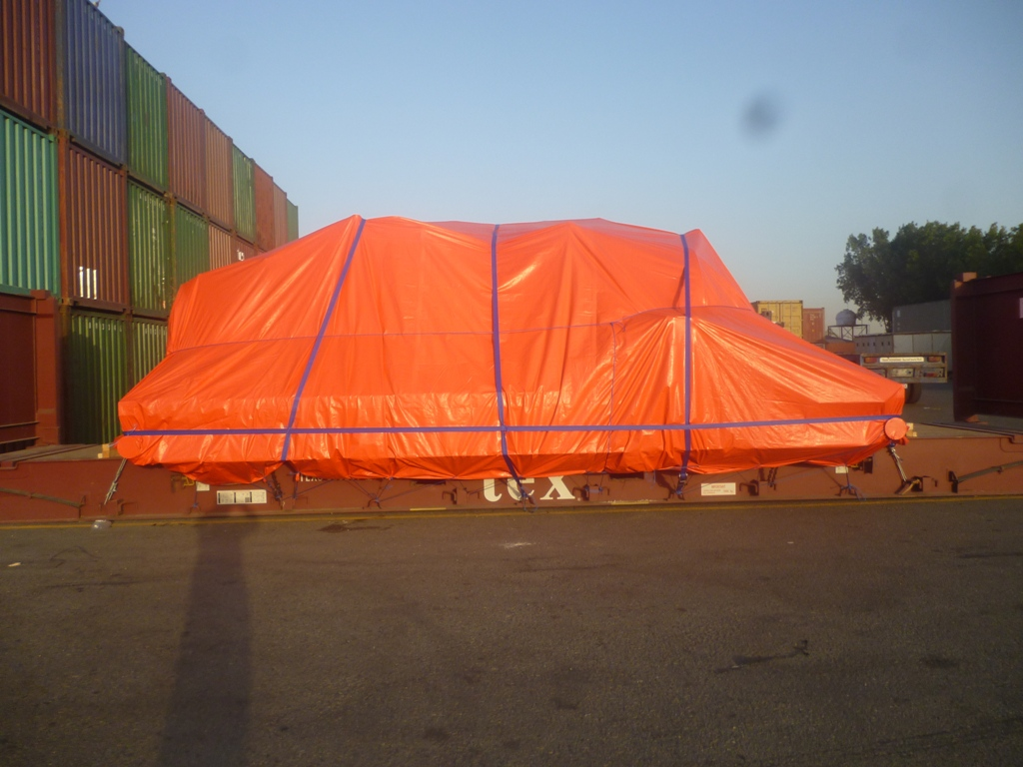
Project Cargo Services

Slide 17
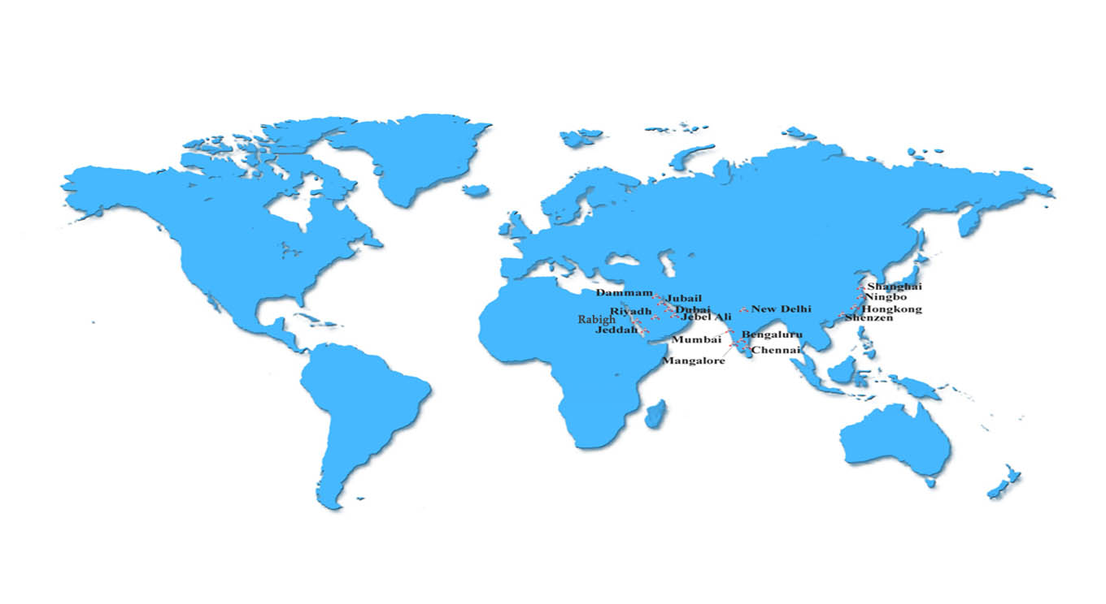
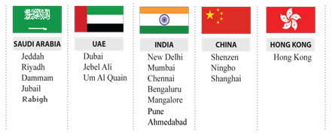
Global Offices

Slide 18

Advantages
Efficiency
Carrier Management
Expertise
Relationship
Team
Work
Visibility

Slide 19
Customer Segment
Petro chem
FMCG
PHARMA
AUTOMOBILES
PACKAGING
RETAIL

Slide 20


Thank You
“ Entrust your valuable cargo to ‘BAFCO International’
and feel the difference in service ”
www.bafcointl.com
Fast . Flexible . Reliable

